Slide 1







INTRODUCTION TO ENVIRONMENTAL SCIENCE

Slide 2



What is Environment?
The word Environment is derived from the French word “Environ” which means “surrounding”. Our surrounding includes biotic factors like human beings, Plants, animals, microbes, etc. and abiotic factors such as light, air, water, soil, etc. Environment is a complex of many variables, which surrounds man as well as the living organisms.
Environment includes water, air and land and the interrelation ships which exist among and between water, air and land and human beings and other living creatures such as plants, animals and micro organisms. The natural environment consist of four interlinking systems namely, the atmosphere, the hydrosphere, the lithosphere and the biosphere. These four systems are in constant change and such changes are affected by human activities and vice versa.

Slide 3
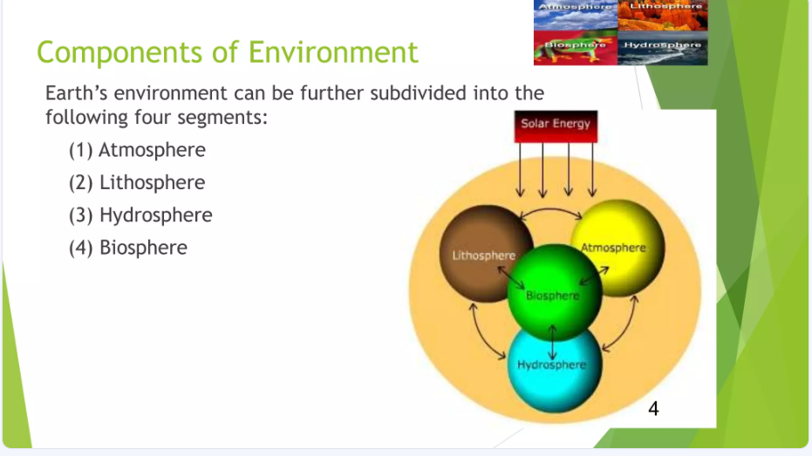
Notes:
Hydrosphere includes all water bodies such as lakes, ponds, rivers, streams and ocean etc. Hydrosphere functions in a cyclic nature, which is termed as hydrological cycle or water cycle.
Lithosphere mainly, contains soil, earth rocks, mountain etc. Lithosphere is divided into three layers-crusts, mantle and core (outer and inner).
Atmosphere is a thin layer which contains gases like oxygen, carbon dioxide etc. and which protects the solid earth and human beings from the harmful radiations of the sun.
Biosphere it is otherwise known as the life layer, it refers to all organisms on the earth’s surface and their interaction with water and air.

Slide 4


What is Environmental Science?
Environmental Science is the study of how living things (like plants, animals, and humans) interact with their surroundings (the air, water, land, and other living things). It looks at how these interactions affect both the environment and the organisms within it.
Environmental Science is an interdisciplinary academic field that integrates physical and biological sciences, to the study of the environment, and the solution of environmental problems. Environmental science provides an integrated, quantitative, and interdisciplinary approach to the study of environmental systems.

Slide 5


Why is it Interdisciplinary?
The term "interdisciplinary" means that environmental science combines knowledge and methods from different scientific areas. Here are the main sciences involved:
1. Biology
What it is: The study of living organisms.
Role in Environmental Science: Biology helps us understand how different species interact with each other and their habitats. For example, studying food chains shows how energy flows through an ecosystem.

Slide 6

2. Chemistry
What it is: The study of substances, their properties, and how they change.
Role in Environmental Science: Chemistry is important for understanding pollutants and how they affect air and water quality. For instance, knowing how chemicals react helps us understand issues like acid rain or greenhouse gases.
3. Physics
What it is: The study of matter, energy, and the forces that act on them.
Role in Environmental Science: Physics helps explain natural processes like climate patterns, energy flow in ecosystems, and the effects of pollution on physical systems (like how heat affects ocean currents).
4. Geology
What it is: The study of the Earth’s structure, materials, and processes.
Role in Environmental Science: Geology provides insights into natural resources (like minerals and fossil fuels) and natural hazards (like earthquakes and landslides). Understanding the Earth’s geology helps us manage land use and conservation efforts.

Slide 7


Importance of Environmental Science
Environmental science is essential for several reasons, helping us understand natural phenomena, the impact of human activities on the environment, and how to find sustainable solutions to ecological problems.

Slide 8

Here’s a simple breakdown of its importance:
1. Understanding Natural Phenomena
Explains Nature: Environmental science helps us learn about natural processes like weather patterns, plant growth, and animal behavior. For example, it explains how seasons change and why certain plants thrive in specific environments.
Ecosystem Interactions: It studies how different living things interact with each other and their surroundings. This knowledge is crucial for maintaining healthy ecosystems where all species can survive.

Slide 9



2. Human Impact on the Environment
Identifying Problems: By studying environmental science, we can see how human actions—like pollution, deforestation, and urban development—affect nature. For instance, we learn how industrial waste can contaminate water sources.
Awareness: Environmental science educates people about the consequences of their actions. Understanding issues like climate change or habitat destruction encourages individuals and communities to make better choices.
3. Finding Sustainable Solutions
Resource Management: Environmental science teaches us how to use natural resources wisely so they can be available for future generations. This includes practices like recycling and using renewable energy sources.
Conservation Efforts: It guides efforts to protect endangered species and restore damaged ecosystems. For example, scientists may develop strategies to save a species that is at risk of extinction by protecting its habitat.
Notes:
T

Slide 10

Key Components In Environmental Science
1. Ecosystems
An ecosystem is a system where living (biotic) and non-living (abiotic) components interact to sustain life.
Biotic Factors: These include all living things like plants, animals, and microorganisms. For example:
Producers: Plants that make their own food using sunlight.
Consumers: Animals that eat plants or other animals.
Decomposers: Organisms like fungi and bacteria that break down dead matter.
Abiotic Factors: These are non-living elements like sunlight, water, air, soil, and temperature. For example:
Sunlight provides energy for plants.
Soil supplies nutrients for plant growth.
Notes:
The interaction between biotic and abiotic factors helps maintain balance in an ecosystem. For instance, plants (biotic) need sunlight and water (abiotic) to grow, and animals depend on plants for food.

Slide 11
2. Natural Resources
Natural resources are materials from nature that humans use. They are classified into two types:
Renewable Resources: These can be replenished naturally over time. Examples:
Solar Energy: Energy from the sun.
Timber: Wood from trees that regrow.
Non-Renewable Resources: These are limited and take millions of years to form. Examples:
Fossil Fuels: Coal, oil, and natural gas.
Minerals: Metals like gold and copper.
Significance: Renewable resources are sustainable if managed well.
Overuse of non-renewable resources can lead to depletion and environmental damage.

Slide 12
3. Biodiversity
Biodiversity refers to the variety of life forms in an ecosystem, including plants, animals, and microorganisms.
Importance of Biodiversity:
It maintains ecosystem balance by ensuring every species plays its role (e.g., pollination by bees or decomposition by fungi).
It helps ecosystems adapt to changes like climate shifts or disease outbreaks.
It provides essential resources for humans, such as food, medicine, and materials.

Slide 13
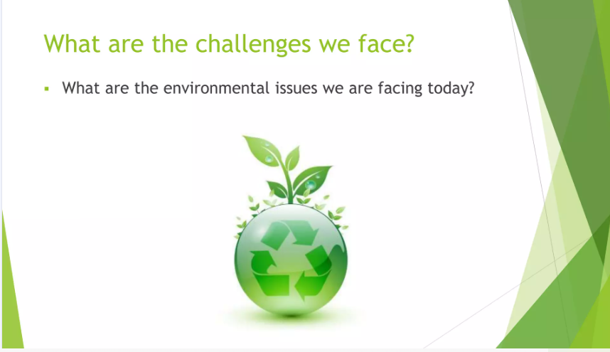

Slide 14
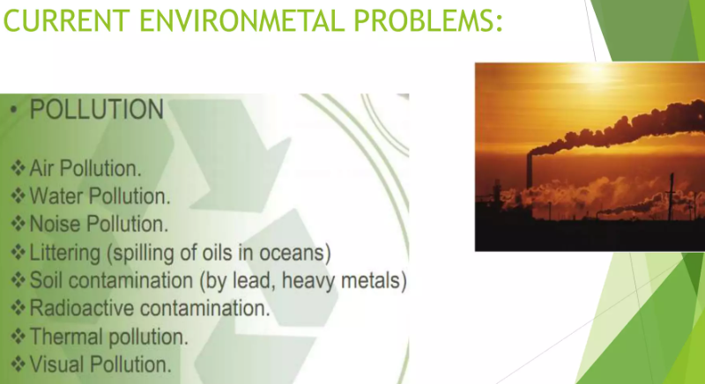
Notes:
Radioactive pollution happens when harmful radioactive materials are released into the environment from things like nuclear power plants, weapon testing, or improper waste disposal, which can be dangerous to humans, animals, and plants because of the radiation they give off.
Thermal pollution occurs when the temperature of a natural body of water is increased or decreased due to human activities, such as industrial processes that release heated or cooled water back into the environment, negatively impacting aquatic life.
Visual pollution refers to the presence of unattractive or disruptive elements in the environment, such as billboards, litter, and poorly designed buildings, which can detract from the natural beauty of an area and affect people's well-being.

Slide 15
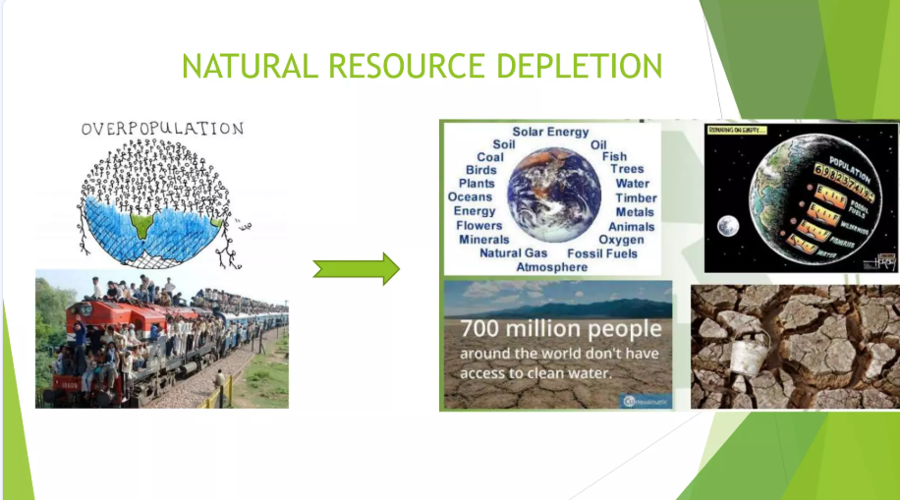

Slide 16
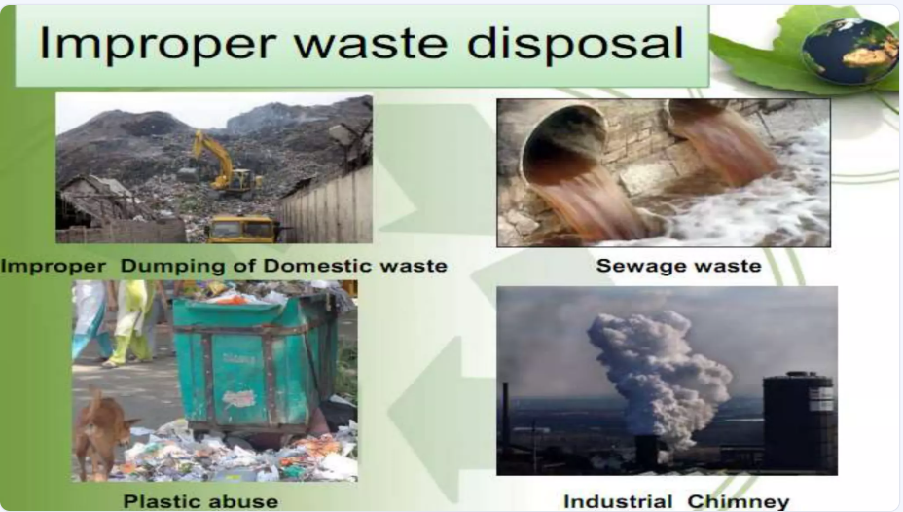

Slide 17
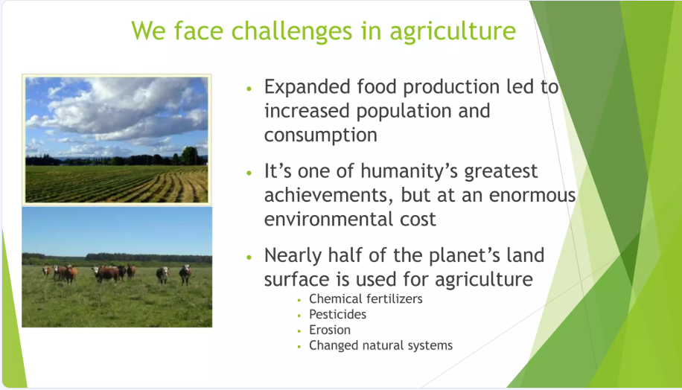

Slide 18
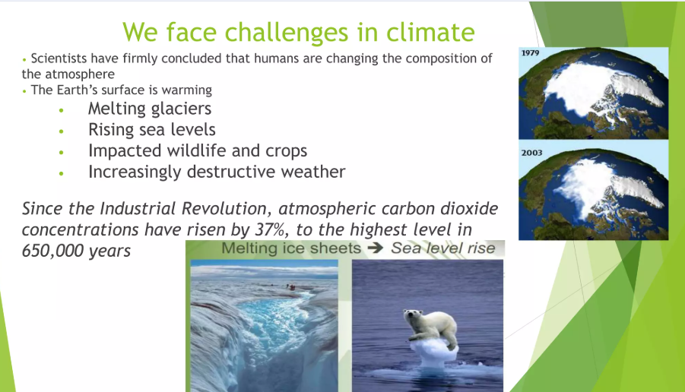

Slide 19
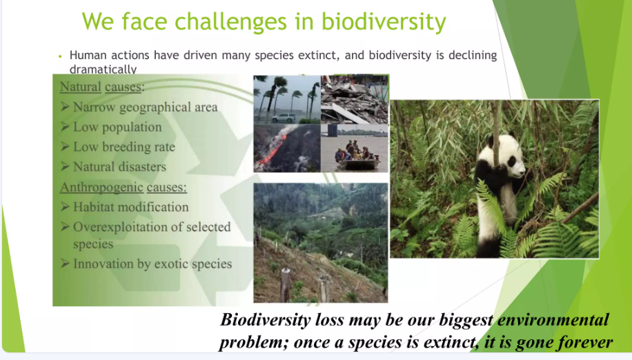
Notes:
A narrow geographical area refers to a small, specific location or region.

Slide 20
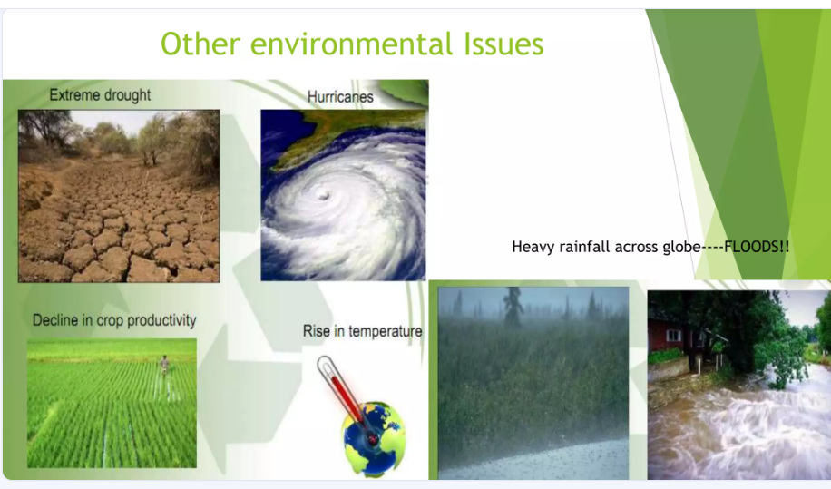

Slide 21
Human Interaction with the Environment
Environmental Ethics in the Philippines
Environmental ethics focuses on how we should use and protect our natural resources. In the Philippines, this concept is particularly relevant due to the country's rich biodiversity and various environmental challenges.
Notes:
It refers to how humans interact with the environment to fulfill their needs and how they respond to these interactions (e.g., cutting down a tree).

Slide 22
Conservation vs. Preservation
Conservation involves using resources wisely to ensure they can be replenished. For example, in the Philippines, sustainable fishing practices are encouraged to maintain fish populations while allowing communities to benefit economically. This approach helps ensure that marine ecosystems remain healthy for future generations.
Preservation means protecting natural areas from human use, keeping them untouched. A notable example in the Philippines is the debate over the Mount Iglit-Baco National Park, where some advocate for preserving its natural state to protect wildlife and biodiversity, while others argue for limited development to support local communities. This reflects differing views on how to balance human needs with environmental protection.
Notes:
Mount Iglit-Baco National Park, also known as Mounts Iglit–Baco Natural Park, is located on the island of Mindoro in the Philippines

Slide 23
Developed vs. Developing Countries
Environmental issues vary significantly between developed and developing countries:
Developed Countries: These nations typically consume more resources and produce higher levels of pollution due to industrialization. They often have better technology for managing waste but still face challenges like air pollution and climate change.
Developing Countries: The Philippines is considered a developing country where many people depend on natural resources for their livelihoods. Issues like deforestation, pollution, and waste management are pressing concerns. For instance, the country generates a large amount of plastic waste, with significant portions ending up in oceans due to inadequate waste management systems.

Slide 24
Solutions and Future Directions
Sustainable Practices
Promoting sustainability involves adopting practices that help protect the environment and conserve resources. Here are some effective strategies:
Recycling: Recycling materials like paper, plastic, and metal helps reduce waste and conserve natural resources. By recycling, we can turn old items into new products, minimizing the need for raw materials.
Renewable Energy Adoption: Using renewable energy sources such as solar, wind, and hydroelectric power reduces our reliance on fossil fuels. Installing solar panels on homes or using wind turbines can lower energy bills and decrease greenhouse gas emissions.
Conservation Efforts: Conservation means using resources wisely to ensure they last for future generations. This includes practices like sustainable fishing, where fish populations are managed to prevent overfishing, and protecting natural habitats to preserve biodiversity.

Slide 25
Composting: Composting food scraps and yard waste creates nutrient-rich soil while reducing the amount of waste sent to landfills. It helps improve soil health and reduces methane emissions from decomposing organic matter.
Reducing Water Use: Simple actions like fixing leaks, using water-saving appliances, and taking shorter showers can significantly reduce water consumption, helping to conserve this precious resource.
Supporting Local Agriculture: Buying locally grown food reduces the carbon footprint associated with transporting food over long distances and supports local farmers.

Slide 26
Policy and Advocacy
Environmental policies play a crucial role in addressing ecological issues and promoting sustainable development. Governments create laws and regulations that guide how we use resources and protect the environment.
Legislation Examples:
The Clean Air Act helps regulate air pollution in many countries, setting standards for air quality to protect public health.
The Endangered Species Act protects threatened and endangered species by regulating their habitats and preventing activities that could harm them.

Slide 27
Notable Movements:
The Earth Day movement, started in 1970, raises awareness about environmental issues and encourages people to take action to protect the planet.
The Paris Agreement, an international treaty on climate change, aims to limit global warming by reducing greenhouse gas emissions through commitments from participating countries.

Slide 28

Thank You

